Slide 1
Publish your Curriculum Vitae
as an API on Django
Section 13
Notes:
[Mandatory Slide] This would be the introduction slide of the topic that you are covering in this section.
When this slide plays, you could talk about the main aim that we’d be covering in this section.

Slide 2
What We’ll Learn
Designing the data model
Coding the Django models and setting up the SQLite DB
Coding the Django views and setting URL routes
The Django admin
Putting it all together and testing with Httpie
Designing the API endpoints
Define the REST resources you want to expose on the API
Generate the Django project structure, write the models and setup the database
Write the Django views and expose them to URL endpoints
Define URLs for the API endpoints and the permission grants on them
The Django admin is an easy tool to perform data entry for Django web apps
Test your API using the powerful Httpie HTTP client

Slide 3
Designing the data model
Notes:
[Mandatory Slide] This would be the introduction slide of the topic that you are covering in this subsection.
When this slide plays, you could talk about the main aim that we’d be covering in this video.

Slide 4
In this Video, we are going to take a look at…
The API we want to create
Data entities
Entity-Relationship diagram
Notes:
[Mandatory Slide]
Before the start of the video, we’d like to highlight what are important topics or pointers that we’d be covering in this video. This slide would immediately follow the intro/name slide. This would just be say 2-3 points for the viewers to know what they are getting into.

Slide 5
The API we want to create
Let’s code with Django a RESTful API that allows users to publish and view their curriculum vitae
The API will accept and return JSON representations for its resources
The API will feature public and protected resources. The protected resources will be accessible only by clients providing a registration proof in the form of an API Token
Notes:
[Mandatory Slide]
Before the start of the video, we’d like to highlight what are important topics or pointers that we’d be covering in this video. This slide would immediately follow the intro/name slide. This would just be say 2-3 points for the viewers to know what they are getting into.

Slide 6
Data entities
The API data model is simple. It is composed by these core business entities:
Skill - the ability to do something with a certain level of espertise
School - a period of education held in a school/institute
Work Experience - a period of work in a company
Curriculum (aka CV) - a set of information describing the work status of a person: her contact info, the schools she attended, the work experiences she had and her skillset
Also the following entities apply:
User - represents a user in Django (provided by the django.contrib.auth out-of-the-box app)
API Token - the grant an API client application needs to provide in order to access protected resources
Entites have of course relationships:
A Curriculum can be bound to any number of schools, work experiences and skills
A Curriculum can be owned by 1 User (if not, it is public)
An API Token must belong to 1 User
Notes:
[Mandatory Slide]
Before the start of the video, we’d like to highlight what are important topics or pointers that we’d be covering in this video. This slide would immediately follow the intro/name slide. This would just be say 2-3 points for the viewers to know what they are getting into.

Slide 7
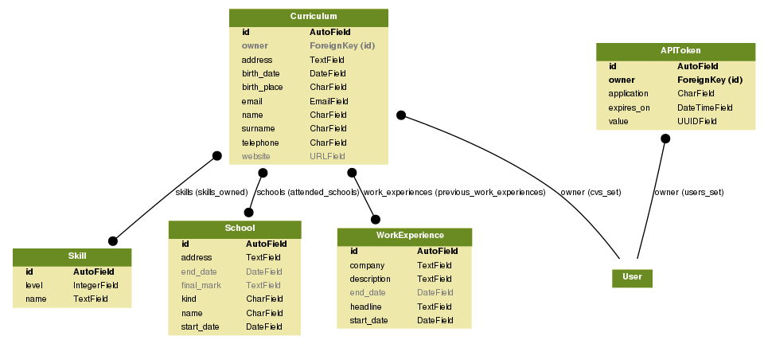
Entity-Relationship diagram
Nullable fields are coloured in grey
Unique fields are coloured in black
N
N
N
N
N
N
N
N
1
0, 1
Notes:
[Mandatory Slide]
Before the start of the video, we’d like to highlight what are important topics or pointers that we’d be covering in this video. This slide would immediately follow the intro/name slide. This would just be say 2-3 points for the viewers to know what they are getting into.

Slide 8
Summary
The API we want to create
Data entities
Entity-Relationship diagram
Notes:
[Mandatory Slide]
Before the start of the video, we’d like to highlight what are important topics or pointers that we’d be covering in this video. This slide would immediately follow the intro/name slide. This would just be say 2-3 points for the viewers to know what they are getting into.

Slide 9
Designing the API endpoints
Next Video
Notes:
[Mandatory Slide]
Here the name of the next video needs to be mentioned. The narration as you guessed it would be just letting the viewer know exactly where we are at and what we’d be taking over next! ☺

